Slide 1


Message broker or queue manager
Producer creates and sends messages to the broker.
Rabbit broker routes those messages, and pushes them to the queues, where they will persist untill the consumers access and process the messages
Consumers subscribe to the queues and receive the messages as they are available

Slide 2
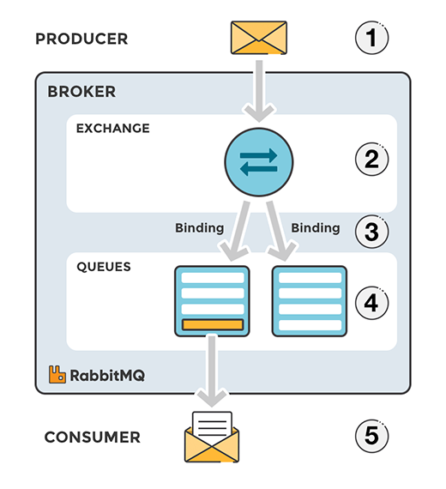
RabbitMQ is capable of handling more than one queue
Exchange
message routing agent -
Receives the messages from the producer, routes them to the right queue
Capable of filtering the messages so that irrelevant information doesn’t pass through (firewall)
Exchange types
Direct (message’s routing key = queue’s binding key)
Topic (routing patterns ~ regexp)
Fanout (enroutes to all ~ broadcast, ignoring routing keys)
Headers (similar to Topic, but routing is done through the values in the headers, rather tan by routing patterns)

Slide 3
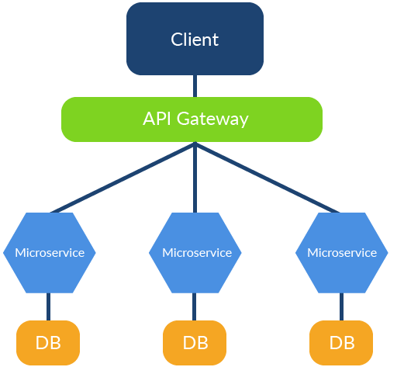
Open source – reliable, on the market since 2007.
Supports several message protocol standards.
Asyncronous processing – it allows putting a message in a queue for later processing.
Ideal for blocking tasks.
Large community, continuous updates, largely used within a lot of companies.
Scalable and flexible – Under heavy load, if the queue grows larger, you can just add more consumers.
When to use RabbitMQ?
Background Jobs - that could take some time
Long running tasks - file scanning, pdf conversión, etc
Microservices - Communication between aplications, avoiding bottlenecks
When NOT to use RabbitMQ?
When your communication is syncronous
When you need to ingest huge ammounts of data - Bigdata
When you need your data to persist for a period of time

Slide 4
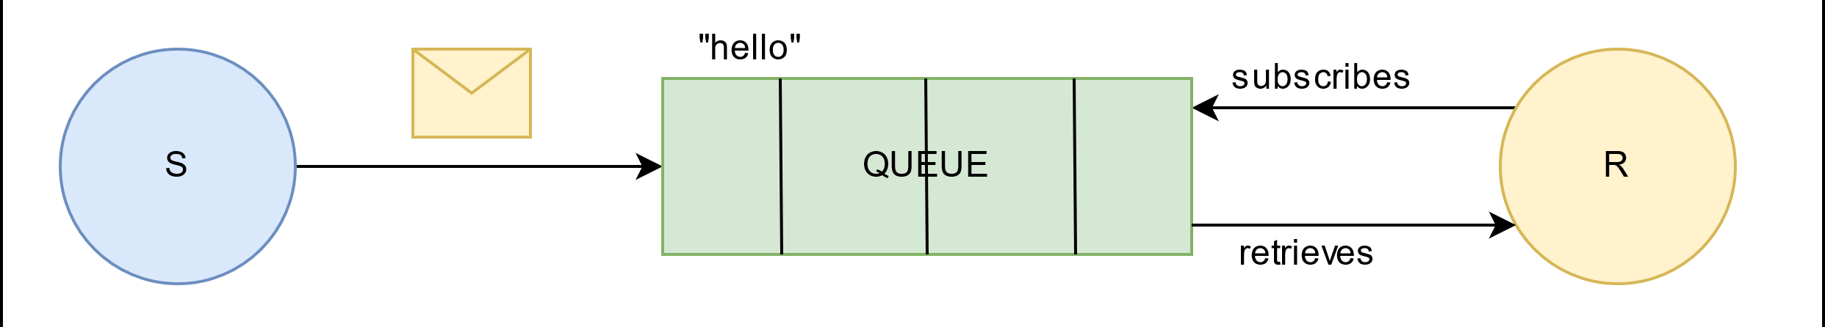
DEMO
Hello world

Slide 5
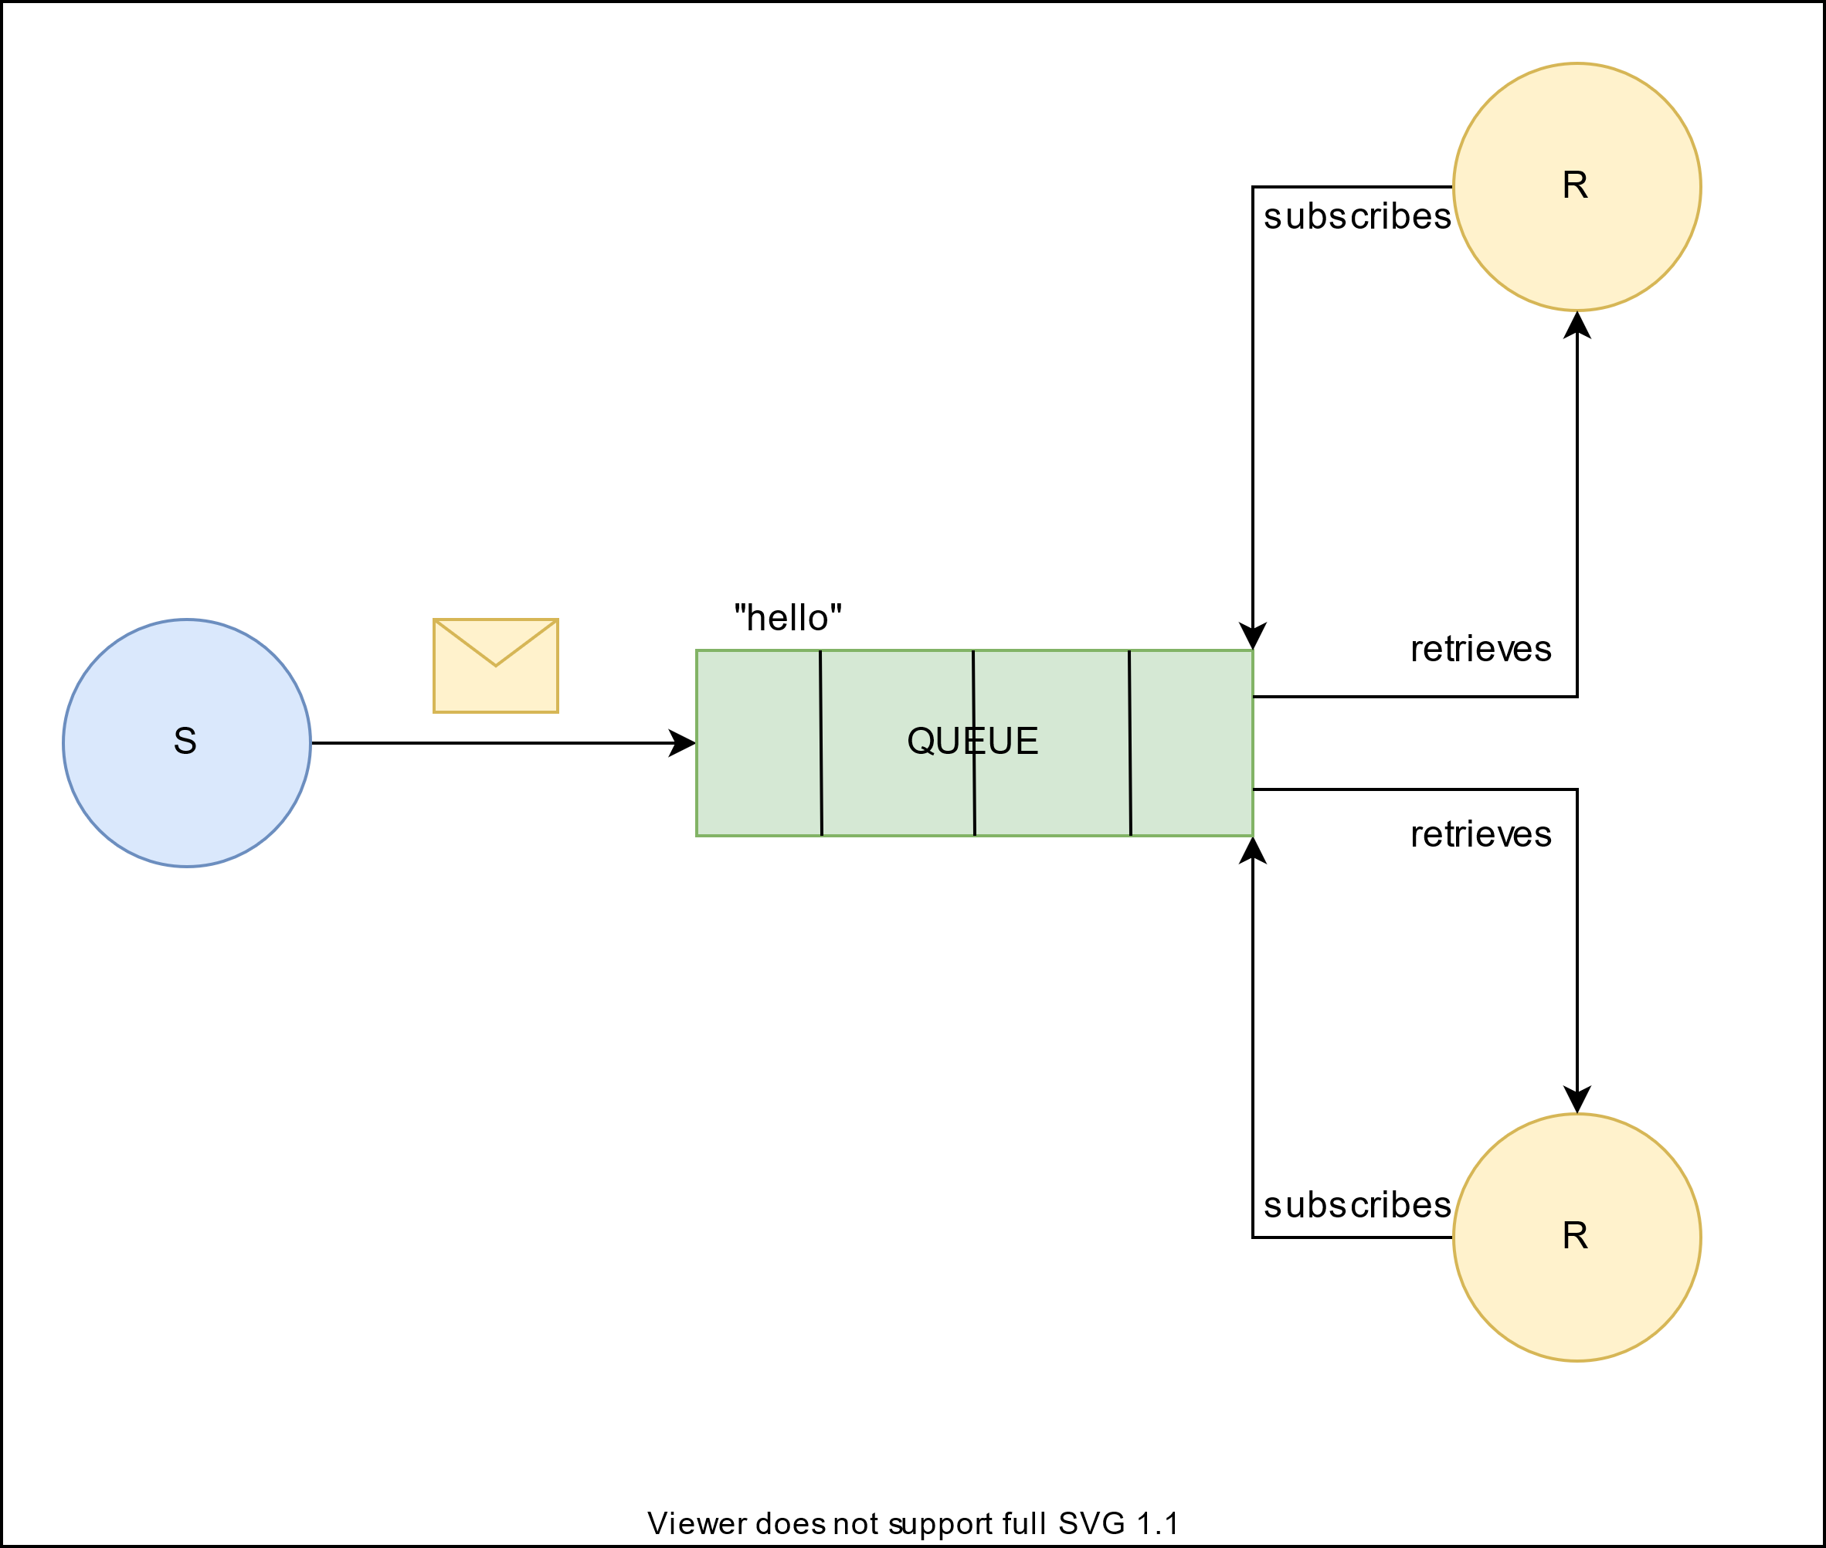
DEMO
Work queue

Slide 6
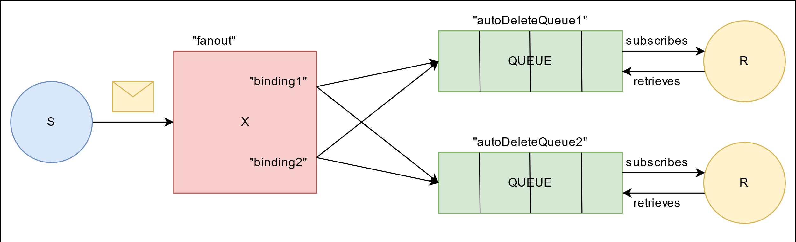
DEMO
Publisher – Consumer

Slide 7
Links
RabbitMQ para principiantes - https://blog.bi-geek.com/rabbitmq-para-principiantes/
What can RabbitMQ do for you ? - https://www.rabbitmq.com/features.html
When to use Rabbit and Kafka ? - https://www.cloudamqp.com/blog/when-to-use-rabbitmq-or-apache-kafka.html
Rabbit MQ: Get started - https://www.rabbitmq.com/#getstarted
RabbitMQ complete tutorials - https://github.com/UltimateSandbox/rabbitmq-tutorials-complete.git
RabbitMQ client - http://localhost:15672/#/

